Slide 1
Sort Types Comparison
An Data Structure & Algorithm project report FCDS-AU'20/21

Slide 2
Group Information
Email
cds.YoussefAdel10819@alexu.edu.eg
Name
Youssef Adel Fathy Ahmed -ID 20201010819- Group 3

Slide 3
TABLE OF CONTENTS
00
11
01
001
packages
Arrays form
Sort Types
Initiation

Slide 4

INTRODUCTION
Algorithms and ideas that to reach the best way to experience a project. It was tough project as our priority is the accomplishment of goals and the ease of use. We searched a lot to find what we need and understanding some concepts were difficult and we hope to raise to your expectations.

Slide 5
00
packages

Slide 6

Packages
We have used 3 packages
1- Scanner has been used to read the user input as an option to choose which sorting method and to continue the program.
2- Arrays used to store a collection of data as elements with the capability to apply changes (methods) on it.
3- random is used to generate random numbers as in class randomizer to insert it in the array.

Slide 7
01
Sort Types

Slide 8
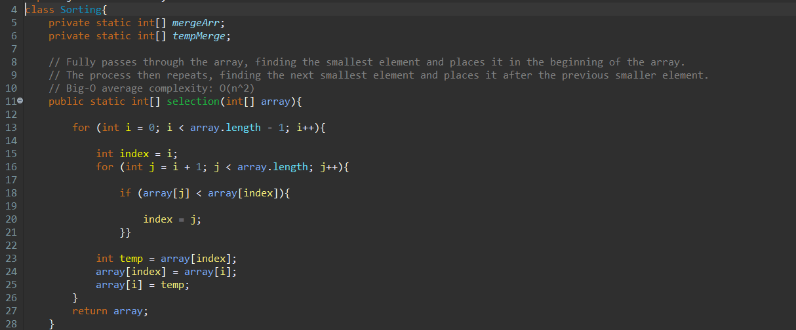

Slide 9
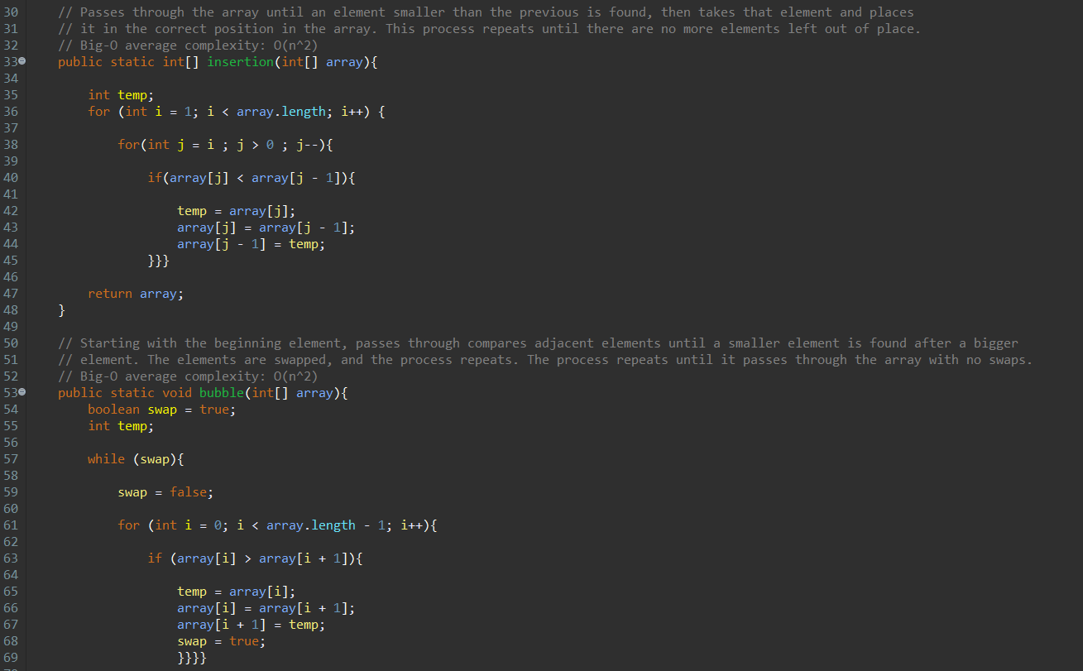

Slide 10
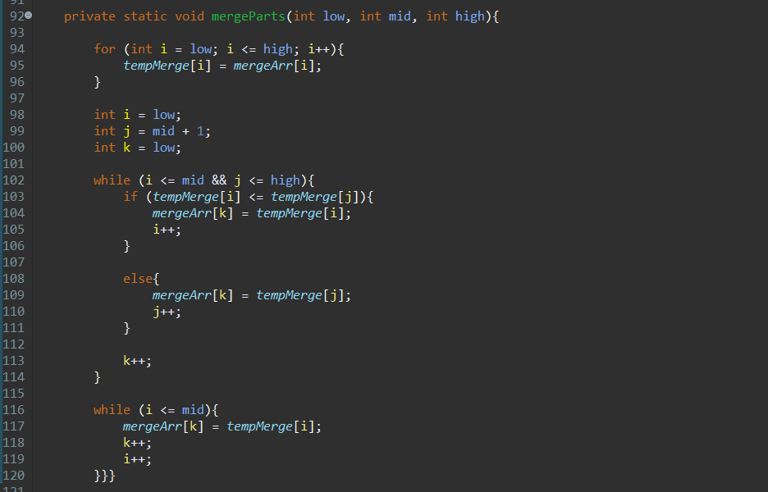

Slide 11
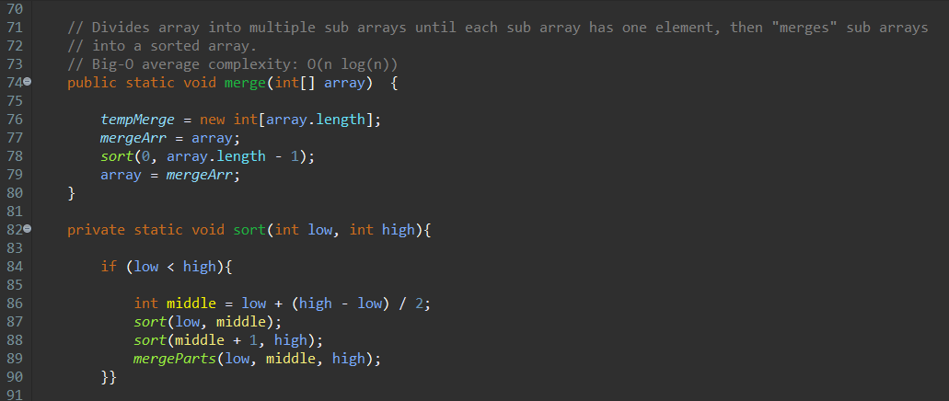

Slide 12
Selection Sort
Its an algorithm that selects the smallest element from a list in each iteration and places that element at the beginning.
1. Set the first element as minimum.
2. Compare minimum with the second element. If the second element is smaller, assign the second element as minimum.
And again compare minimum with the third element until the last element.
3. After each iteration, minimum is placed in the front of the unsorted list.
4. For each iteration, indexing starts from the first unsorted element. Step 1 to 3 are repeated until all the elements are sorted.

Slide 13

Insertion Sort
An algorithm that places element at its suitable place in each iteration, works similarly as we sort cards in our hand.
1. The first element in the array is assumed to be sorted. Take the second element and store it separately in key.
Compare key with the first element. If the first element is greater than key, then key is placed in front of the first element.
2. Take the third element and compare it with the elements on the left. Placed it behind the element smaller than it. If there is not, place it at the beginning.
3. Similarly, place every element at its correct position.

Slide 14
Bubble Sort
It’s an algorithm compares two adjacent elements and swaps them if they are not in the intended order.
First Iteration (Compare and Swap):
1. Starting from the first index, compare the first and the second elements.
2. If the first element is greater than the second element, they are swapped.
3. Now, compare the second and the third. Swap them if they are not in order.
4. The process goes on until the last.
Remaining Iteration:
The same goes on for the remaining.
After each iteration, the largest element among the unsorted is placed at the end.

Slide 15
Merge Sort
Using the Divide and Conquer technique.
Divides array into multiple sub arrays until each sub array has one element, then "merges" sub arrays into a sorted array.
The mergeparts(low, mid, high) is a key process that assumes that arr[p..q] and arr[q+1..r] are sorted and merges the two sorted sub-arrays into one
Suppose we had to sort an array as A[p..r].
Divide: make q is the half-way point between p and r, then split the subarray A[p..r] into 2 arrays A[p..q] and A[q+1, r].

Slide 16
Merge Sort
Combine: When get 2 sorted subarrays A[p..q] and A[q+1, r] for array A[p..r], we combine the results by creating a sorted array A[p..r] from 2 sorted subarrays A[p..q] and A[q+1, r].
Conquer: try to sort both the subarrays A[p..q] and A[q+1, r]. If we haven't yet reached the base case, we again divide both these subarrays and try to sort them.

Slide 17
11
Arrays form

Slide 18
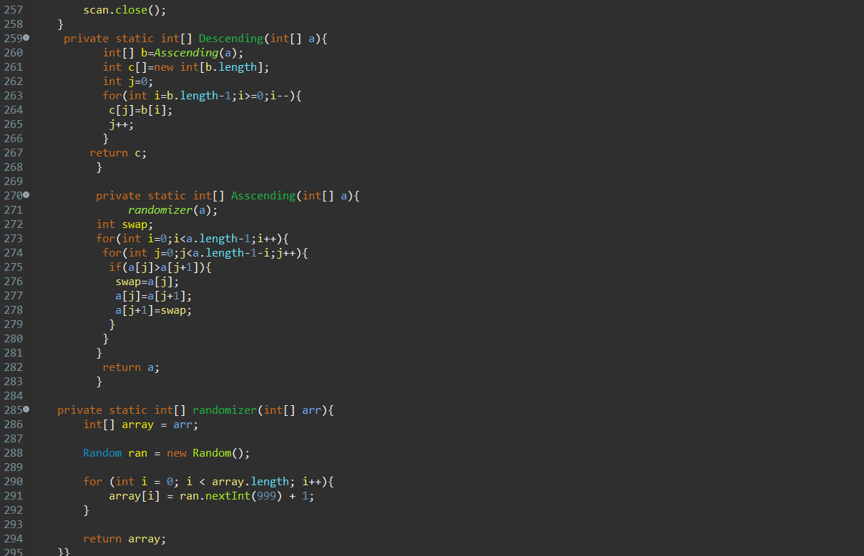

Slide 19
randomizer
Randamizer method was used to randomize the arrays for the tests use the ran.nextInt function in a for loop to apply it on every element.
We initialize an array to modify and the use the for loop then we return it.

Slide 20
Ascending
Asscending method was used to produce a ascending array.
First we used the randomizer to get value for ever index in the array
The we used nested for loops to swap elements according to he is bigger and applying it to the whole array
Then we return the modified array

Slide 21
Descending
Descending method was used to produce a descending array.
We used Asscending method so that we get the array filled up and be in ascending order
As the array is in ascending order we use for loop in reverse fashion so that we reverse the values in the array (it become descending this way)
Then we returned the modified array

Slide 22
001
Initiation

Slide 23
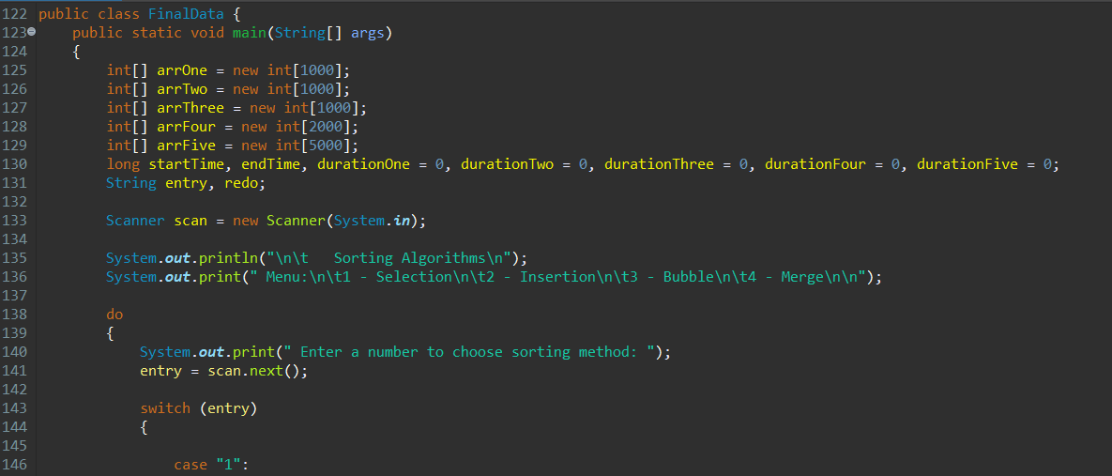

Slide 24
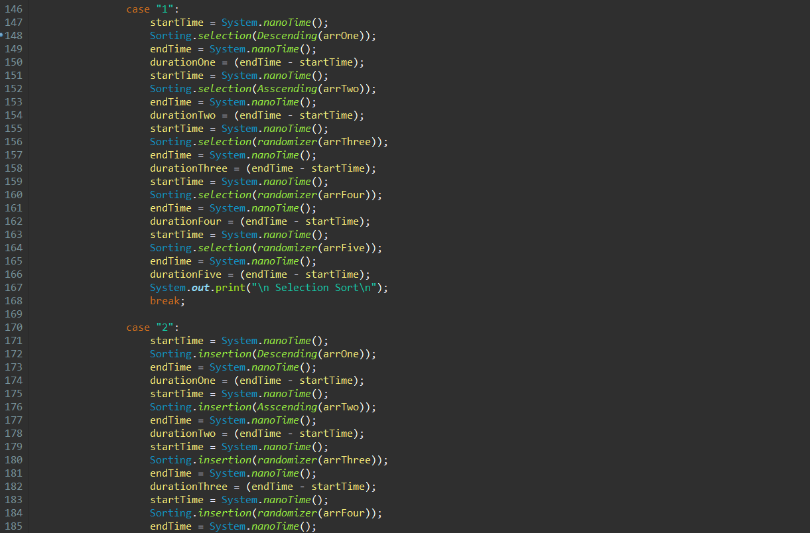

Slide 25
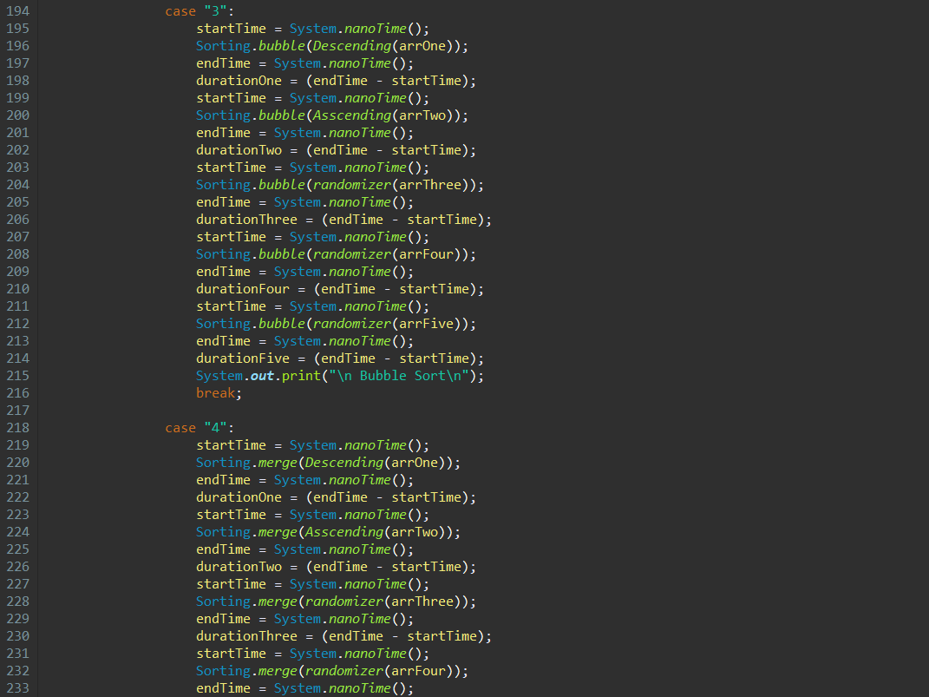

Slide 26
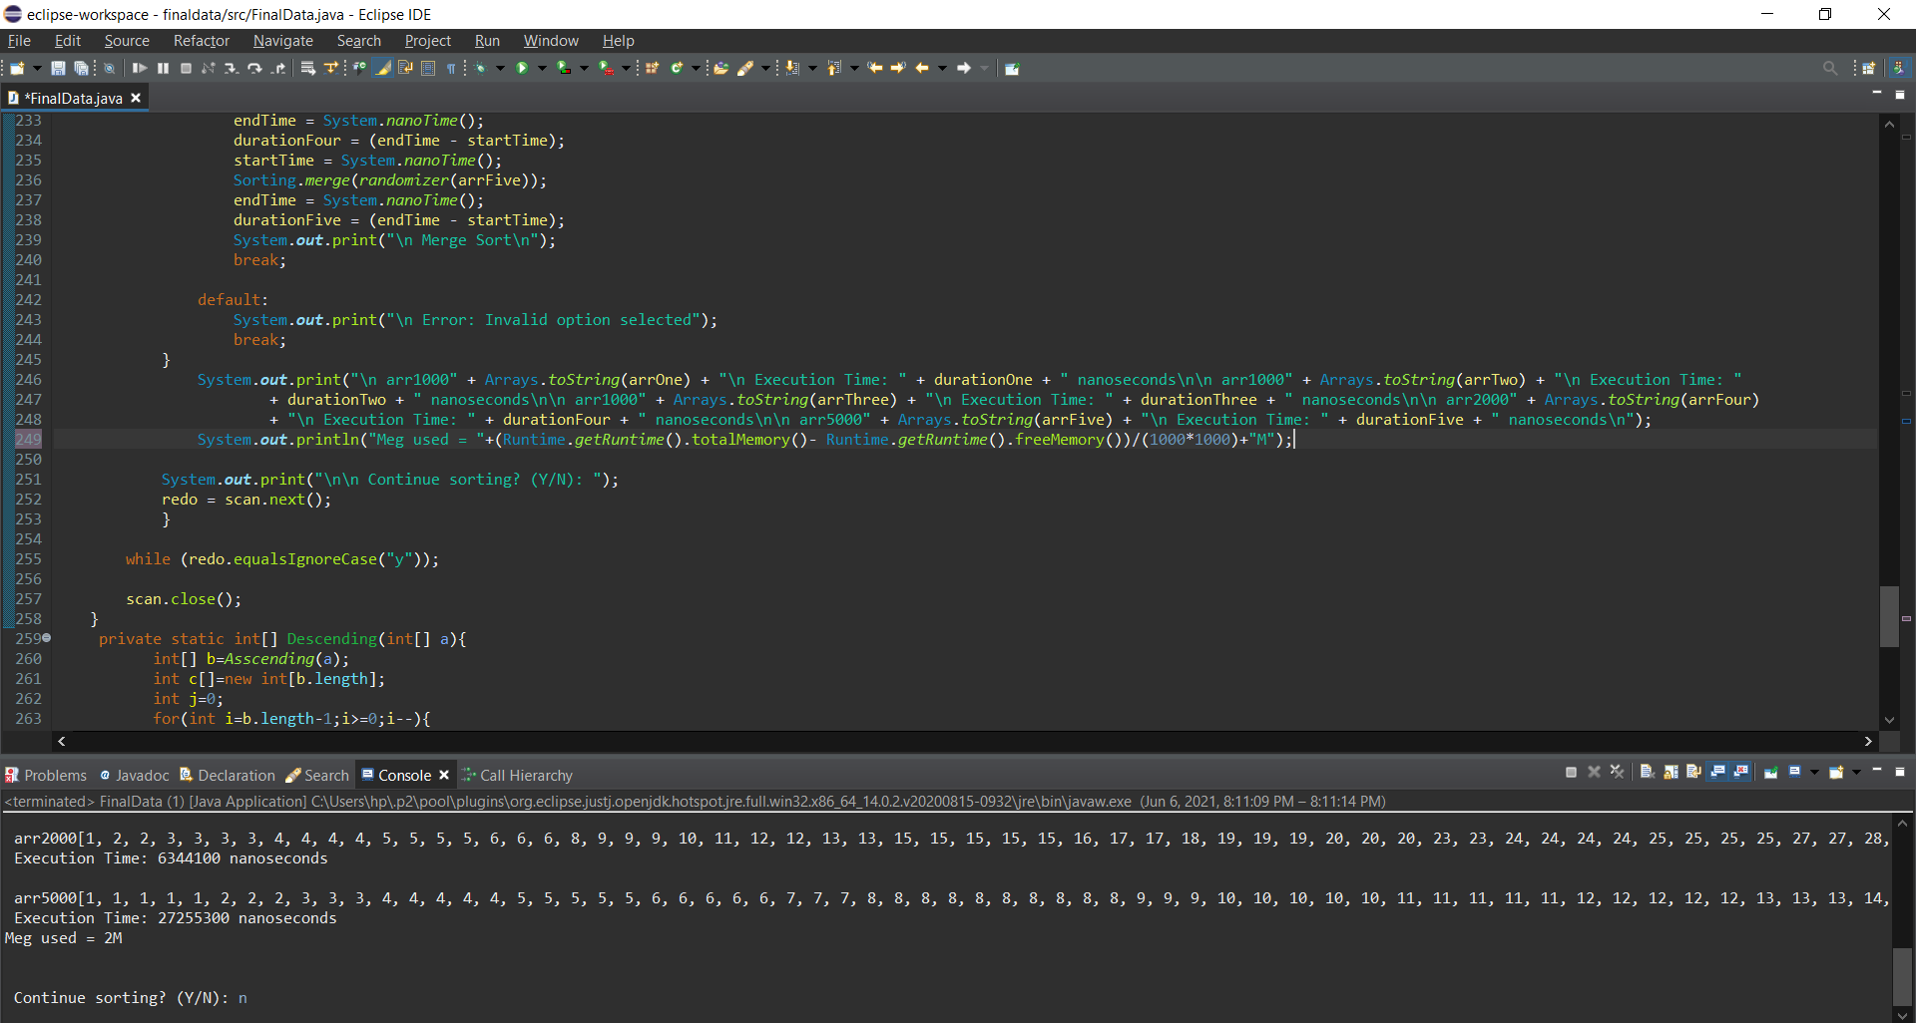

Slide 27
Values & Scanner
First we initialize the arrays so that we have a test subjects
3 arrays with the same number of elements so that we can use them for randomize and ascending and descending test (compare them so that they most be the same number of elements)
Then 2 arrays we more num of elements to compare by size.
We initialize the scanner so that we can interact with the user
We interacted with the user using series of dialogs and receiving the answers via the scanner through out the project

Slide 28
Do & switch cases
We apply the orders of the user via switch-case (the most optimal why)
Then we apply every case (which is filling the array, randomize the array ascending the array , etc) by calling the methods we construct in the project in order way
We used System.nanoTime to calculate the time of the sorting only by using to times the start and the end time then (-) them
Repeat that for every case.

Slide 29
Result & continue?
We default for error dialog
Then we communicate the result to the user using System.out.println that shows every array after being sorted with accumulated for each and the memory used for the program to run.
then we offer to sort again by the same or different method
In the end we close the interaction using scan.close

Slide 30
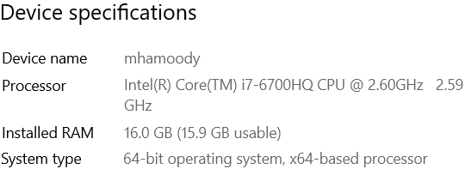
Device specs

Slide 31
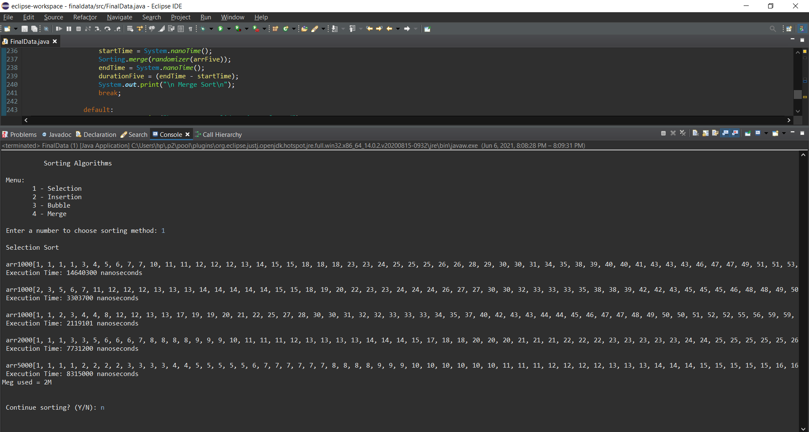
END RESULT

Slide 33
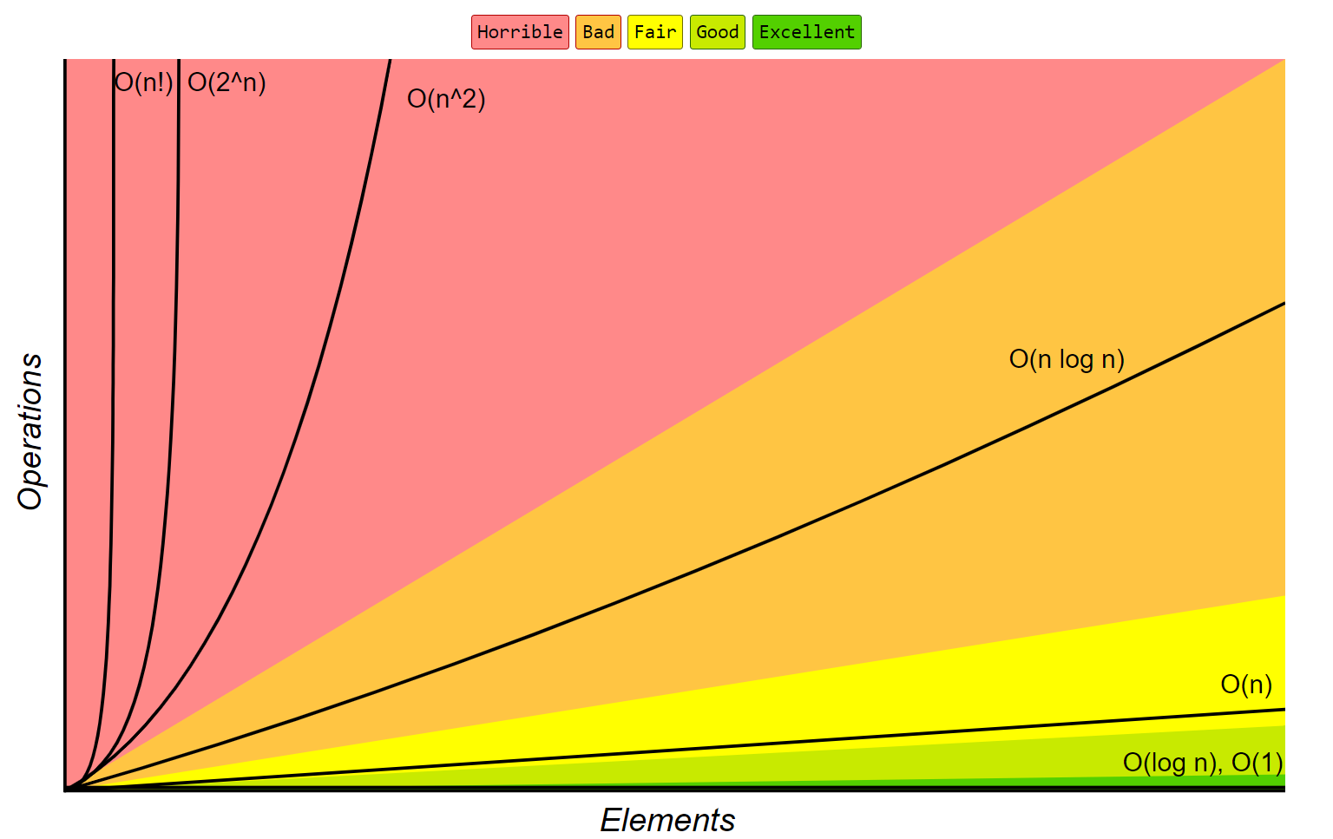

Slide 34
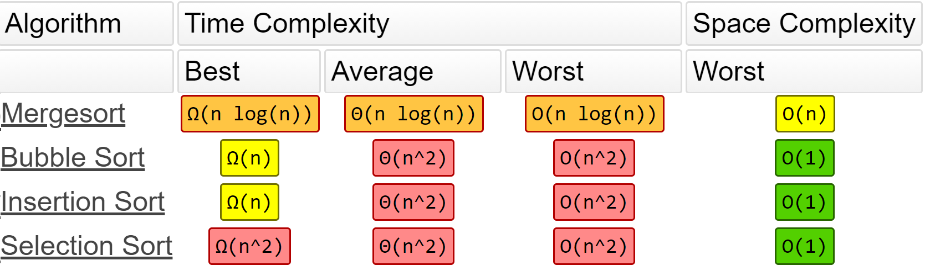

Slide 35

THANKS!
Hope this presentation satisfies with the outmost understanding for the way the project works by the best fastest methods we could puzzle out

